Slide 1

Red Black Trees
A Self-Balancing Binary Tree

Slide 2
Definition
What is a Red-Black Tree?
A Red-Black Tree is a type of self-balancing binary search tree where each node has an extra bit for color—either red or black.
This color is used to enforce balance rules that keep the tree's height logarithmic, ensuring fast operations. It supports insert, delete and search in O(log n) time, Maintains a balanced structure automatically and balance is preserved through rotations and recoloring.
Properties of Red-Black Trees
A Red-Black Tree have the following properties:
Node Color: Each node is either red or black.
Root Property: The root of the tree is always black.
Red Property: Red nodes cannot have red children (no two consecutive red nodes on any path).
Black Property: Every path from a node to its descendant null nodes (leaves) has the same number of black nodes.
Leaf Property: All leaves (NIL nodes) are black.

Slide 3
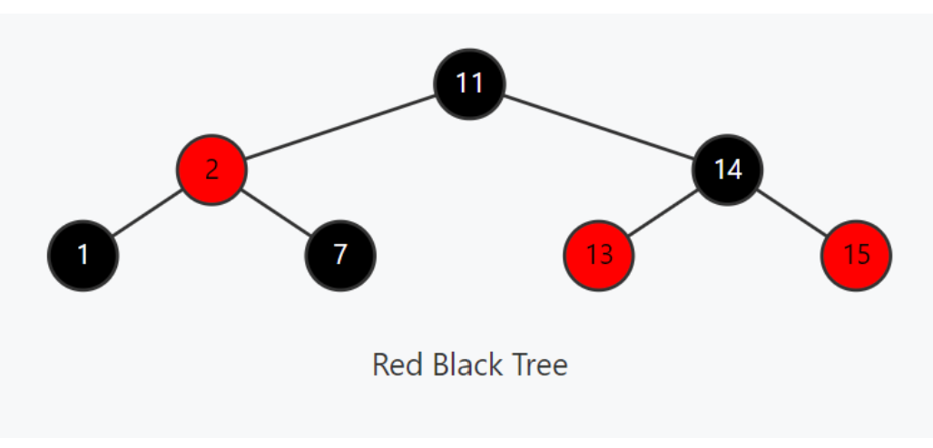
Example of Red-black tree
Why Red-Black Trees?
Red-Black Trees guarantee the tree stays approximately always balanced
even after many inserts and deletes.
Ensures that the longest path is no more than twice as long as the shortest path.
Keeps tree height at O(log n), enabling consistently fast operations.

Slide 4

Visual Example of RedBlack Trees

Slide 5
Red-Black Tree Operations
Operation | Description | Time Complexity | Space Complexity
Insert | Inserts a new element into the tree. | O(log n) | O(1)
Delete node | Removes an element from the tree. | O(log n) | O(1)
Search | Searches for an element in the tree. | O(log n) | O(1)
Left Rotate | Performs a left rotation on a given node. | O(1) | O(1)
Right Rotate | Performs a right rotation on a given node. | O(1)

Slide 6
Applications of Red Black Tree
Red-black trees are used to implement associative arrays and set data structures in many programming languages, such as Java's Tree Map and Tree Set, and C++'s std::map and std::set.
They are used in memory management within operating systems, particularly in the Linux kernel for efficiently organizing and searching ranges of free memory.
Red-black trees are employed in process scheduling algorithms in operating systems, where tasks need to be efficiently inserted, removed, and searched based on priority.
They are utilized in database management systems for implementing efficient indexing structures, allowing for fast insertion, deletion, and lookup operations.
Red-black trees are used to implement symbol tables in compilers and interpreters, enabling efficient storage and retrieval of variable and function names

Slide 7

Live Representation of RedBlack Trees

Slide 8
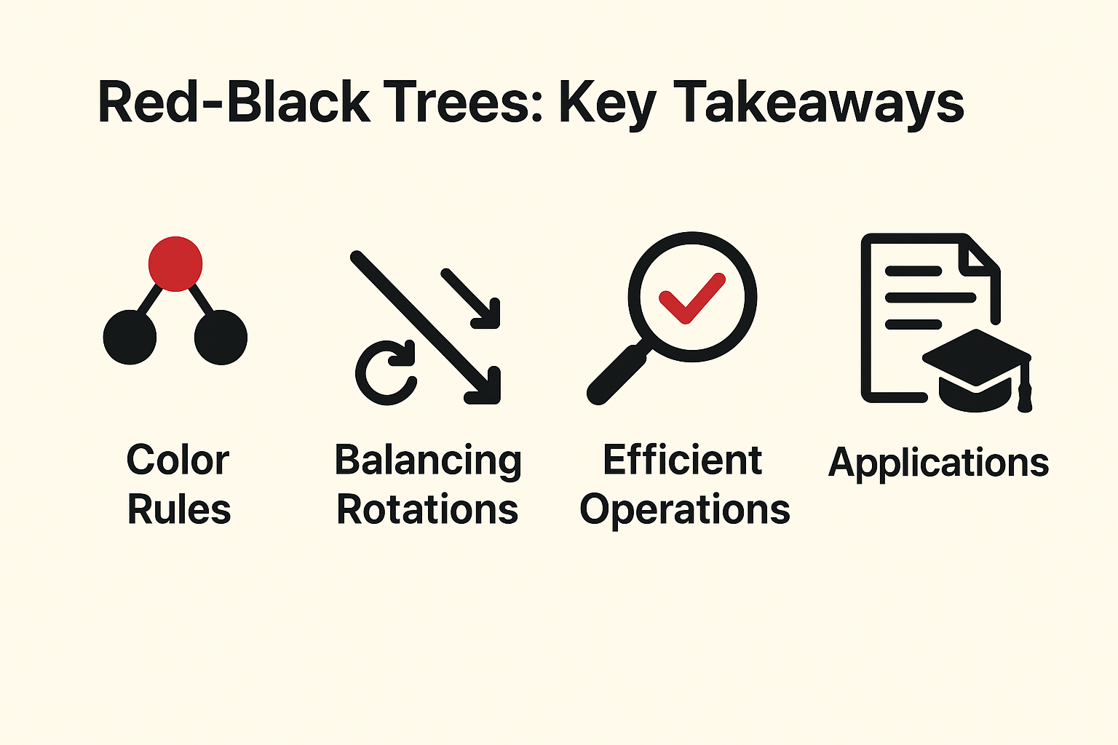
Conclusion
Red-Black Trees strike a powerful balance between structure and efficiency. By enforcing color-based rules and rotations, they maintain near-optimal height, ensuring fast search, insert, and delete operations. Their self-balancing nature makes them a cornerstone of many real-world applications—from associative containers in C++ STL to memory management systems.
In essence, Red-Black Trees exemplify how thoughtful design in data structures can lead to robust, scalable solutions. Understanding them not only deepens our grasp of algorithms but also equips us to tackle complex problems with clarity and precision.

Slide 9

References
https://github.com/Eniolaakinola/Red-Black-Trees.git
https://www.geeksforgeeks.org/cpp/red-black-tree-in-cpp/
https://medium.com/@ben.tom.vincent/why-use-a-red-black-tree-over-a-regular-binary-search-tree-a63857916907
https://www.alamy.com/problem-solving-concept-a-man-thinks-and-solves-a-problem-a-boy-with-laptop-a-luminous-bulb-as-symbol-of-the-appearance-of-a-creative-idea-cartoon-image387800933.html

